Slide 1
Semantic Web
Group 08
Alex Javier Pinduisaca Muñoz
Sebastian Revilla Rojas
Angel Astiazarán Gafo
Mario Villarín García
Lucas Rodriguez Llera

Slide 2
Index
Introduction
Initial Planning
CVS Analysis
OpenRefine
Linking With Data
Ontology
Sparql Queries
Tools we have used
Challenges with tools
Conclussion

Slide 3
Introduction
In this Project we aim to analyze data on public parking in Madrid to integrate it into smart city applications.
Why focus on public parking?
Impact on Urban Mobility
Reduction of Emissions
https://datos.gob.es/es/catalogo/l01280796-aparcamientos-publicos-municipales

Slide 4

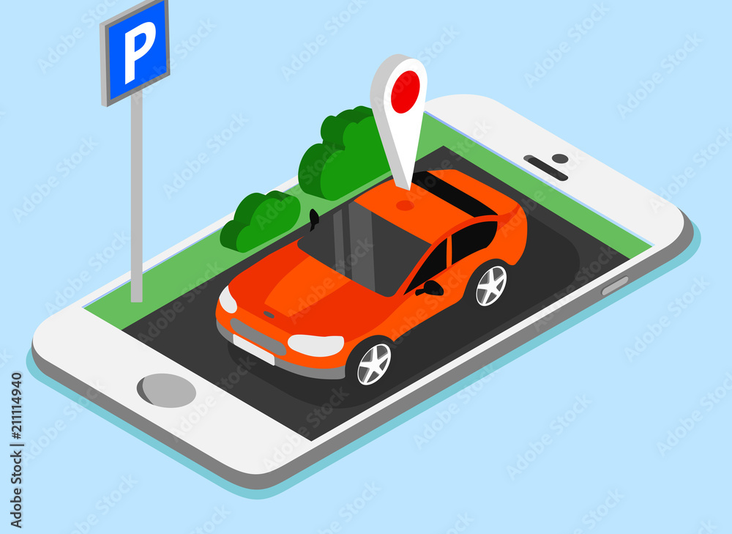
Initial Planning
We thought that the best use for our dataset was an app to find parking in Madrid.
If you are in X location, the app shows you via GPS the nearest parking, their schedule, type of vehicles they allow and total spaces.

Slide 5
CSV Analysis
Parking Slots in the City of Madrid
Analysis of the data: Pk, name, schedule, description, street_name, street_number, neighbourhood, district.
License: commercial and non-commercial use.
Objective: search parking slots by streets and districts.

Slide 6
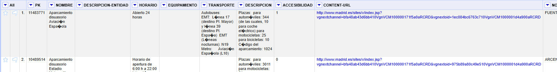
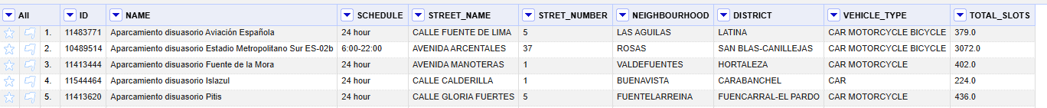
OpenRefine
Original
Reduce to the classes we want
Extract the necessary information from description
After changes
Translate each column to its data type, either as text or as a number.

Slide 7

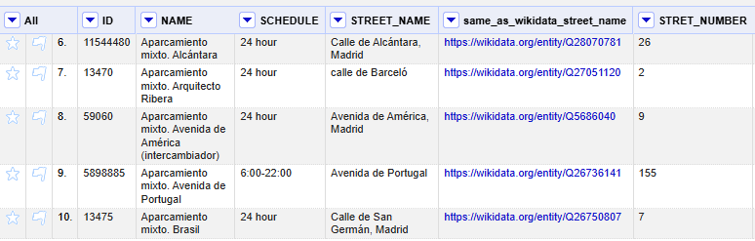
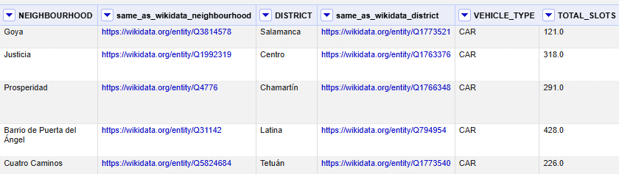
Linking With Data
owl:sameAs
Street_name
Neighbourhood
District

Slide 8
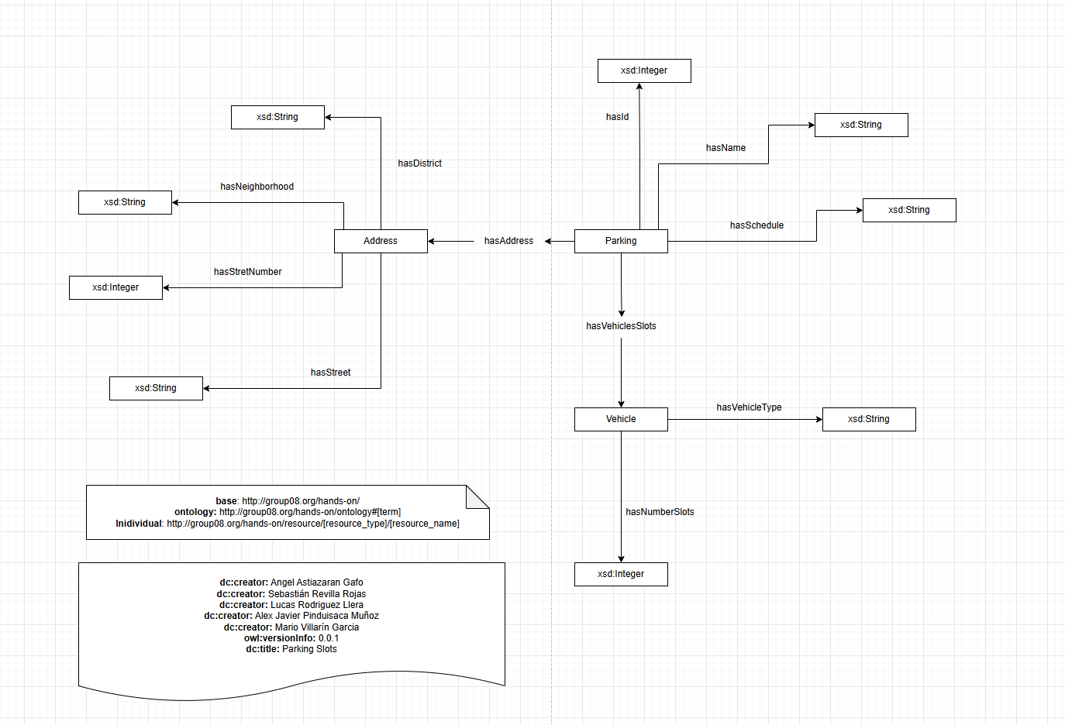
Ontology
For the development of the ontology, we used the tool draw.io

Slide 9
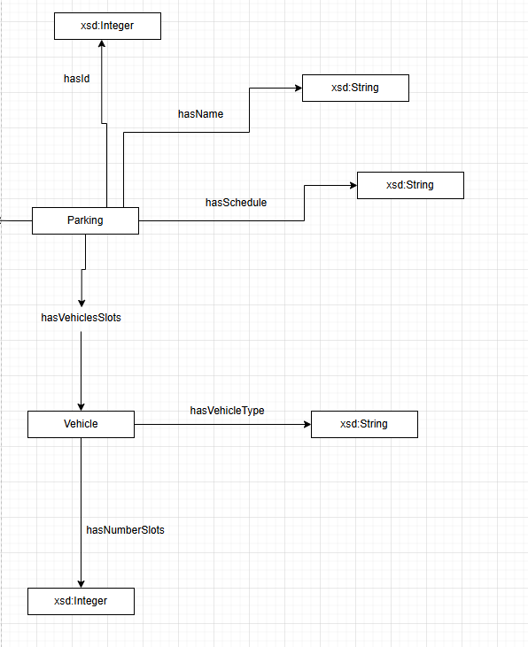
Ontology
Main Classes
Parking
Vehicle
Key Relationships
Has VehicleSlots

Slide 10
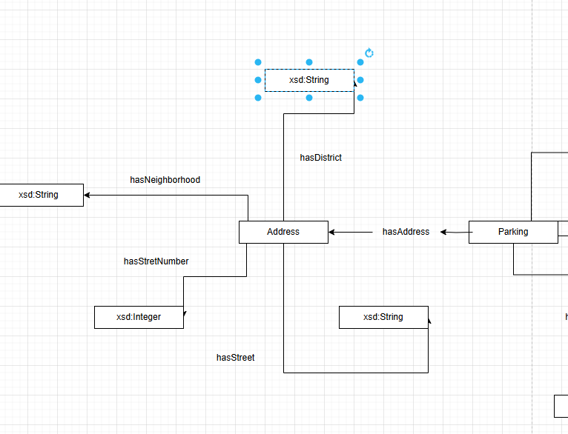
Ontology
Main Classes
Address
Parking
Key RelationShips
hasAddress

Slide 11
SPARQL Queries
Objectives:
Extract targeted information, such as parking availability in particular neighborhoods or districts.
Analyze patterns and trends, like the distribution of parking facilities across the city.
Identify details about parking hours, location, and capacity, which can be used to improve mobility services.

Slide 12
SPARQL Queries
List of neighborhoods and their districts
List of all streets and their numbers
Parking locations in a specific neighborhood
Parking count per district
Parking facilities with specific hours
Parking locations in a specific district

Slide 13
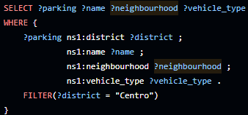
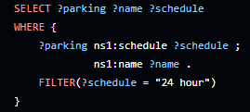
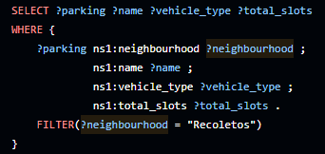
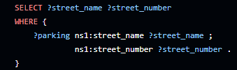
SPARQL Queries

Slide 14
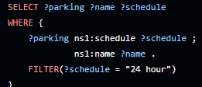
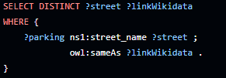
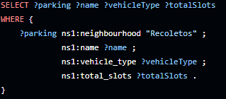
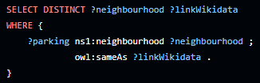
SPARQL Queries with links

Slide 15






Tools We Have Used

Slide 16

Challenges with tools

Slide 17
Conclusions
Parking spaces are a necessity in the city
Cleaning data and linking it is a priority
Live updates of free parking spaces could be profitable

